Slide 1
RANDOM MAP GENERATION
Nadine Gutiérrez Pociño

Slide 2
Map Types

Slide 3
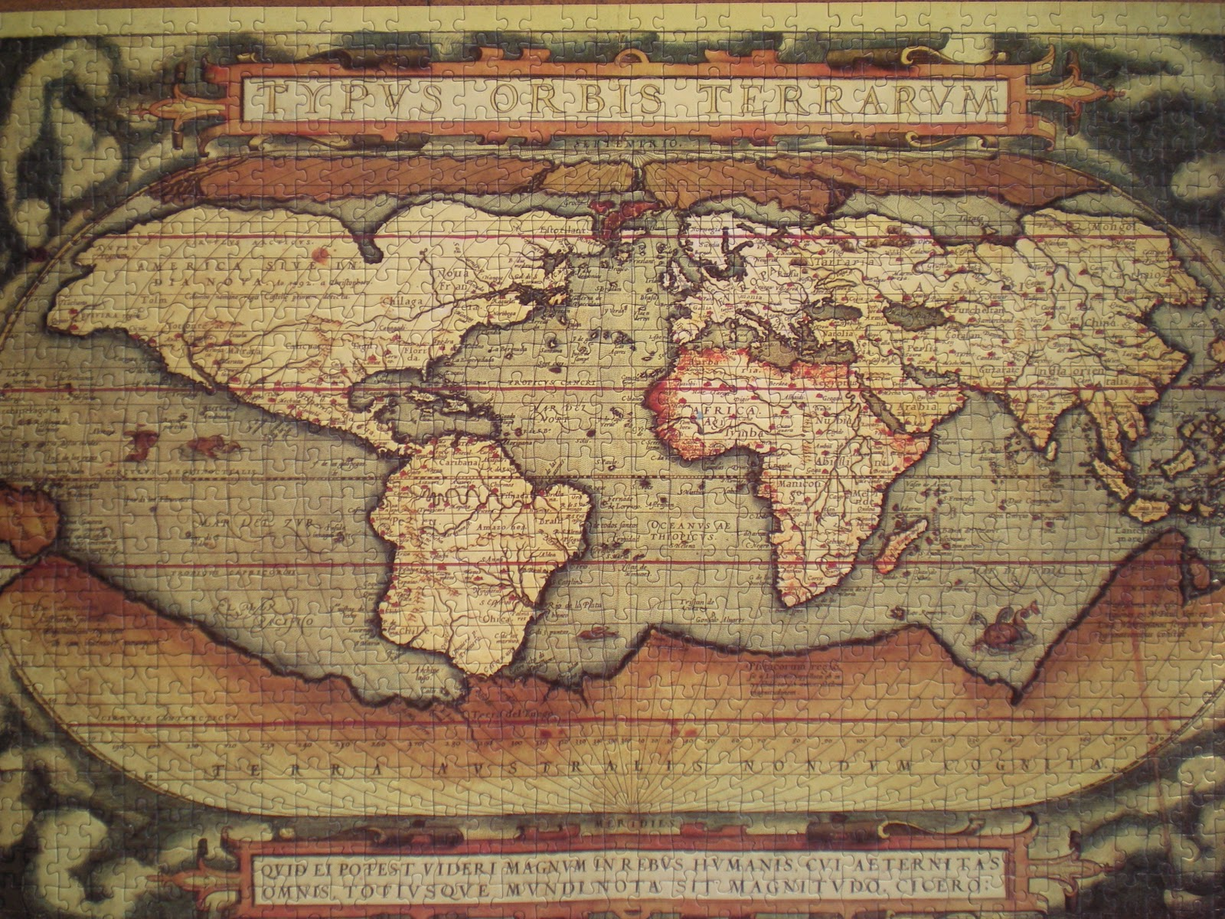
Map Types

Slide 4
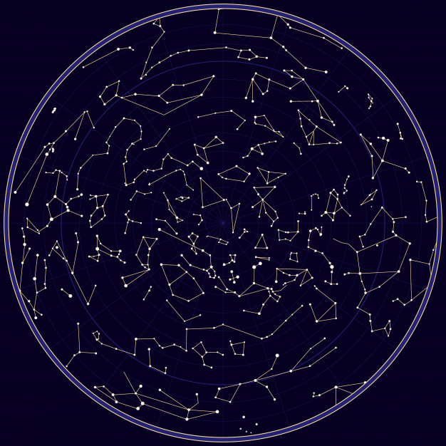
Map Types

Slide 5
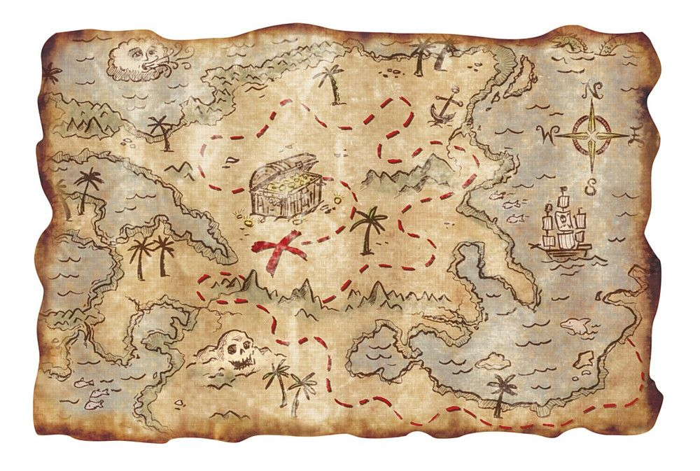
Map Types

Slide 6
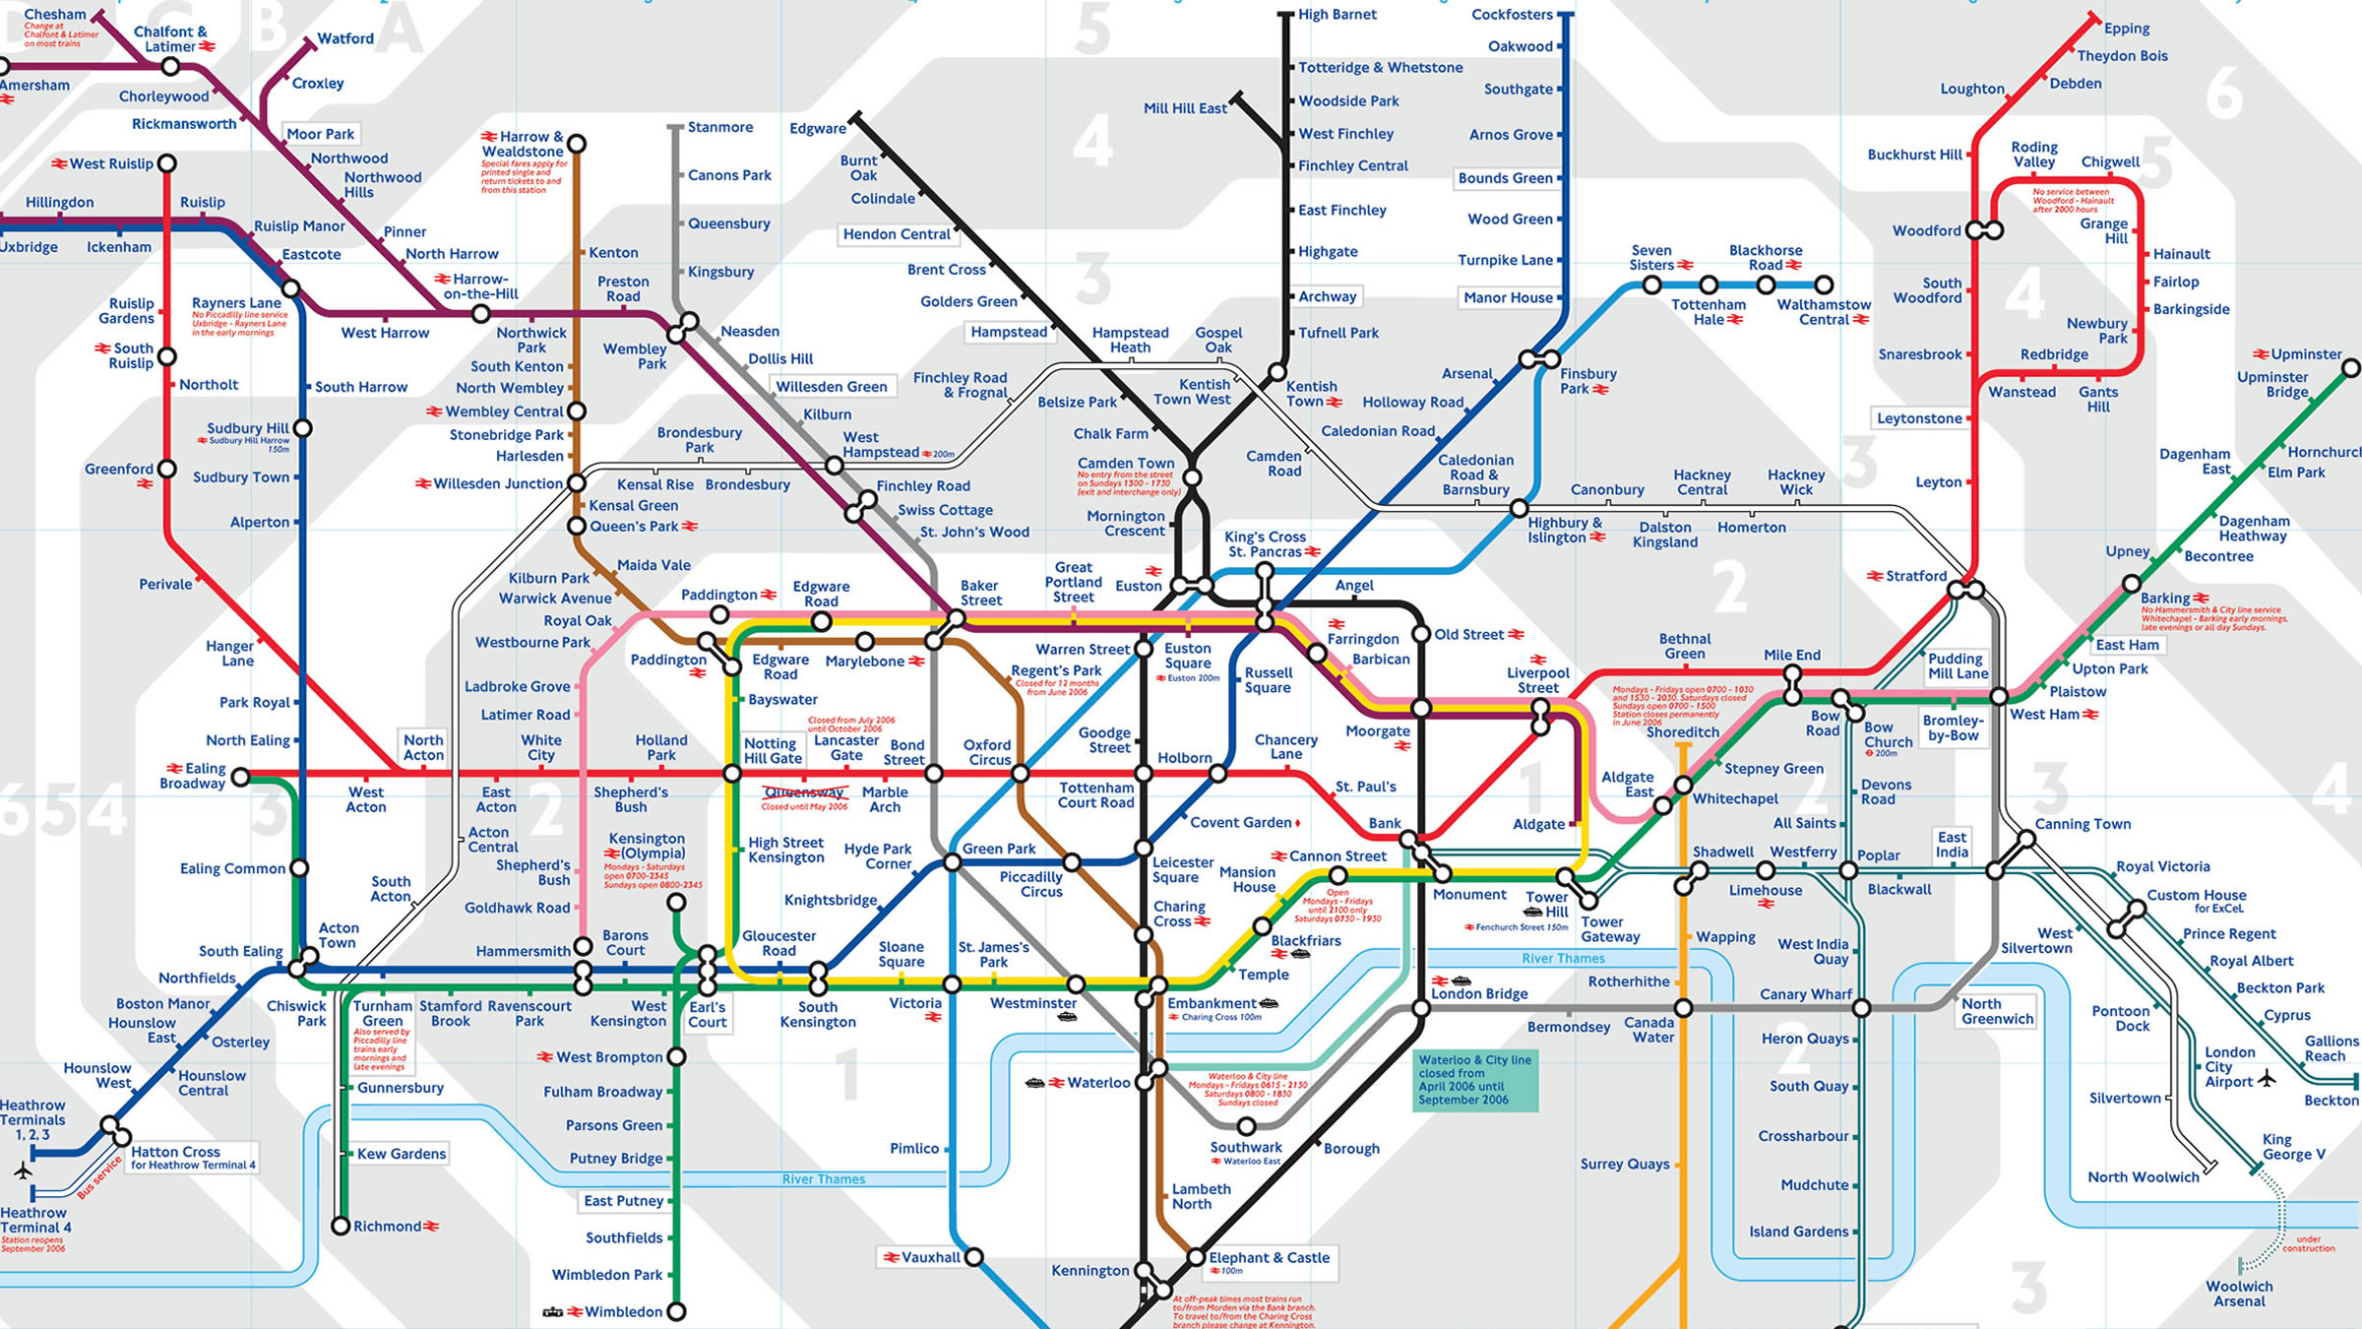
Map Types

Slide 7
Videogame Map Types

Slide 8
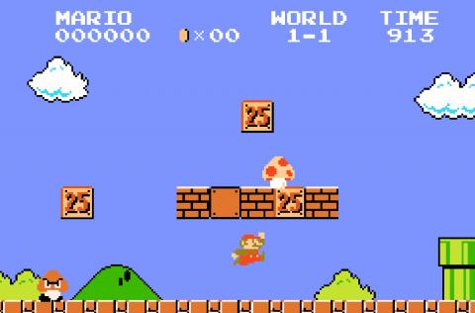
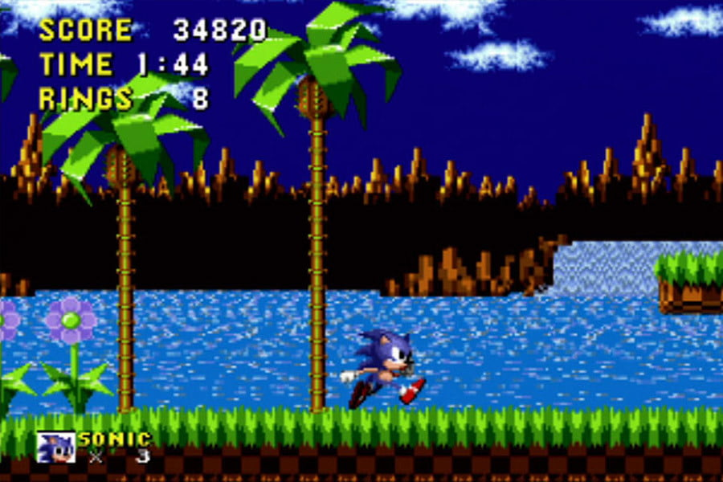
Videogame Map Types

Slide 9
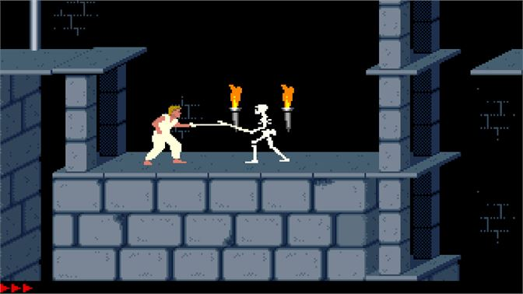
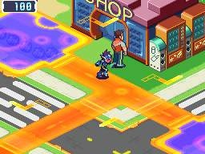
Videogame Map Types

Slide 10
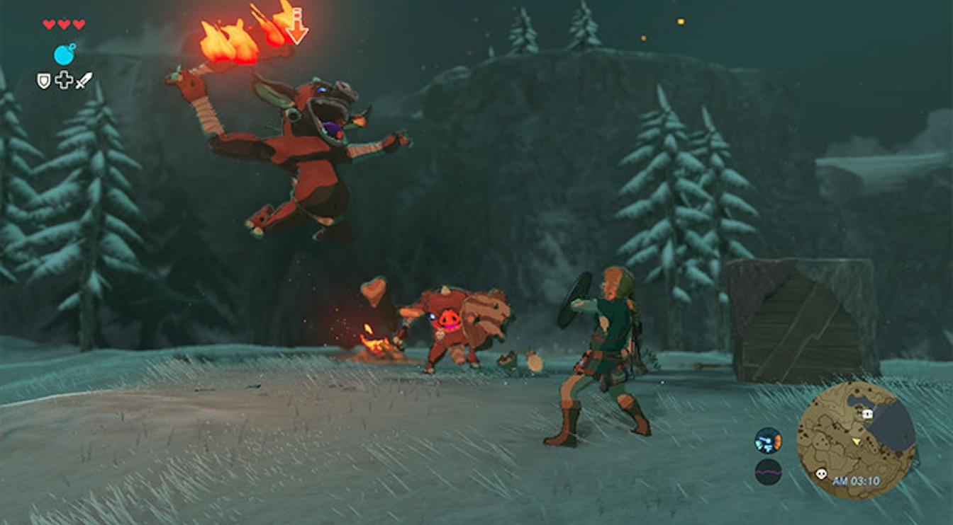
Videogame Map Types

Slide 11
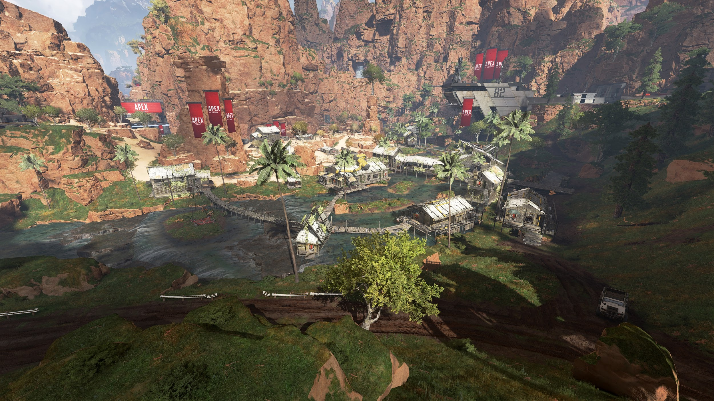
Videogame Map Types

Slide 12
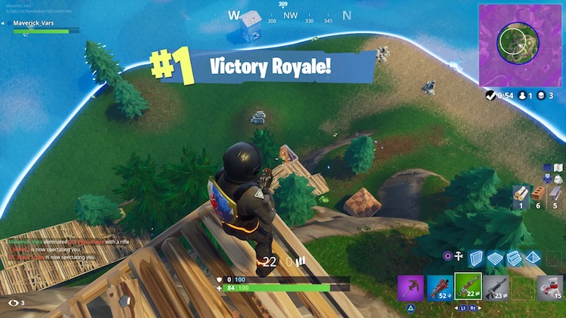
Videogame Map Types

Slide 13
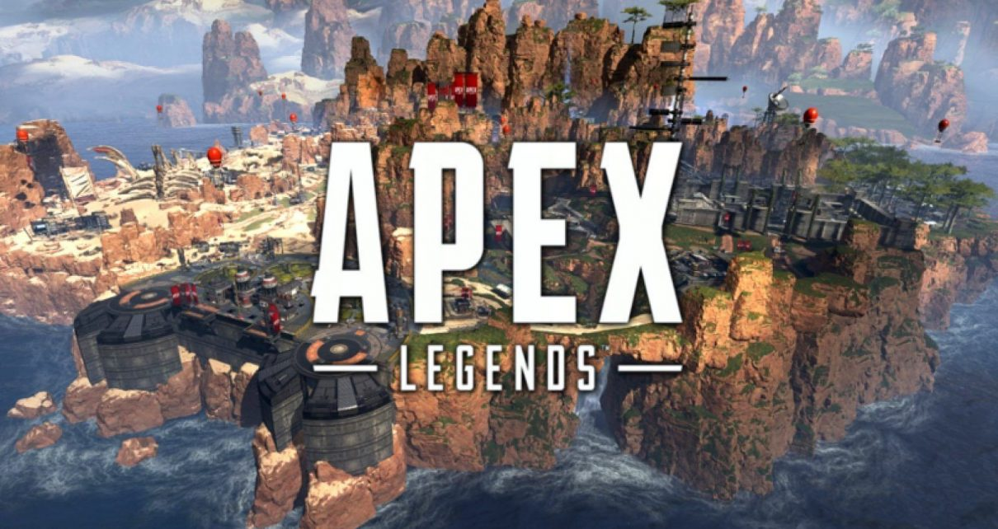
Videogame Map Types

Slide 14
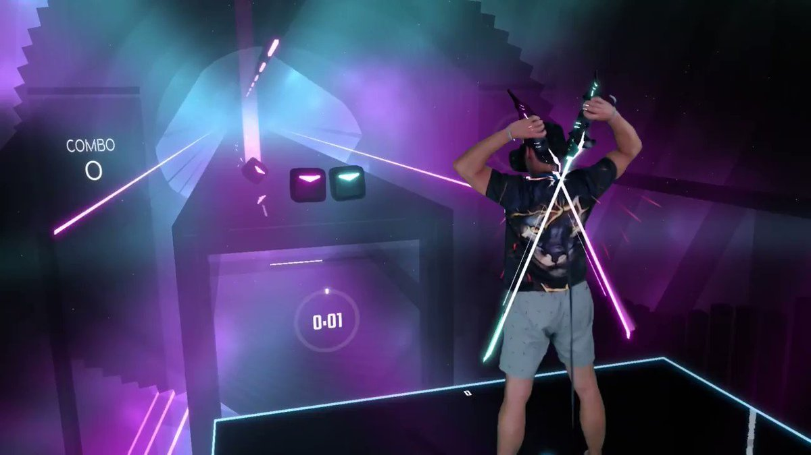
Videogame Map Types

Slide 15
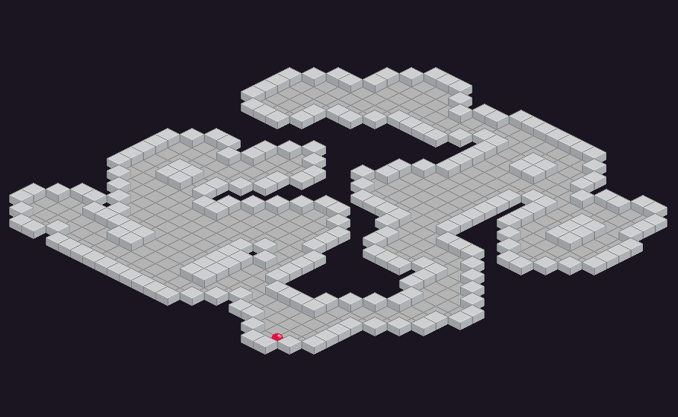
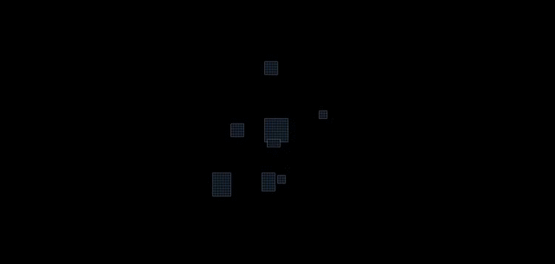
Videogame Map Types: Algorithms

Slide 16
Videogame Map Types: Algorithms
Vlambeer

Slide 17
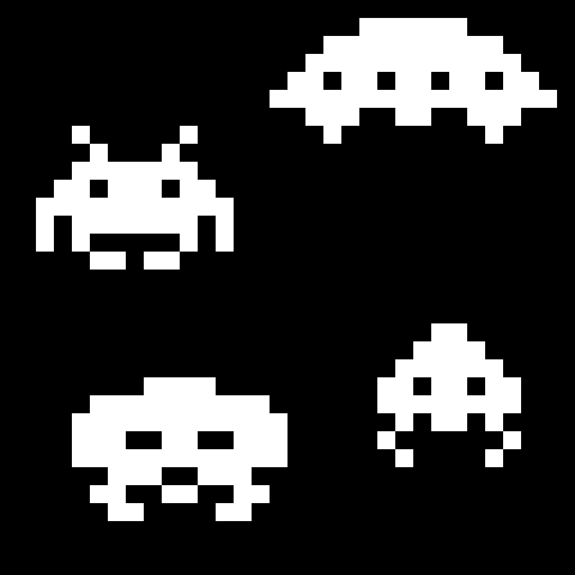
First random algorithms in games

Slide 18
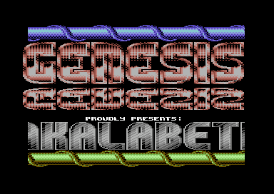
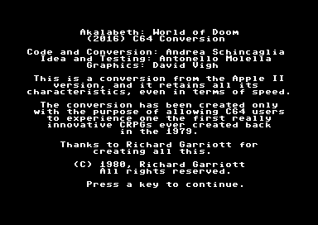
First random algorithms in games
AKALABETH: WORLD OF DOOM (1979)
Apple II (PC), RICHARD GARRIOT

Slide 19
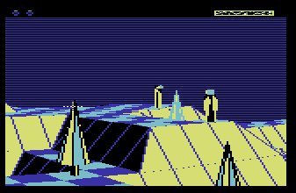
First random algorithms in games
THE SENTINEL (1986)
BBC Micro, GEOFF CRAMMOND

Slide 20
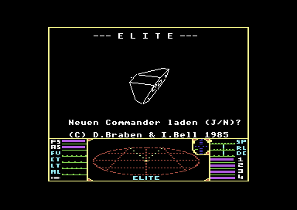
First random algorithms in games
ELITE (1984)
BBC Micro, DAVID BRABEN, IAN BELL

Slide 21
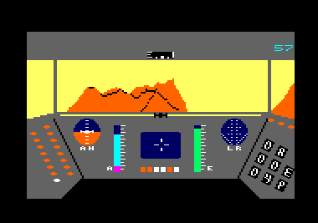
First random algorithms in games
RESCUE ON FRACTALUS (1984)
ATARI 8 BITS, ATARI 5200, Lucasfilm Games

Slide 22
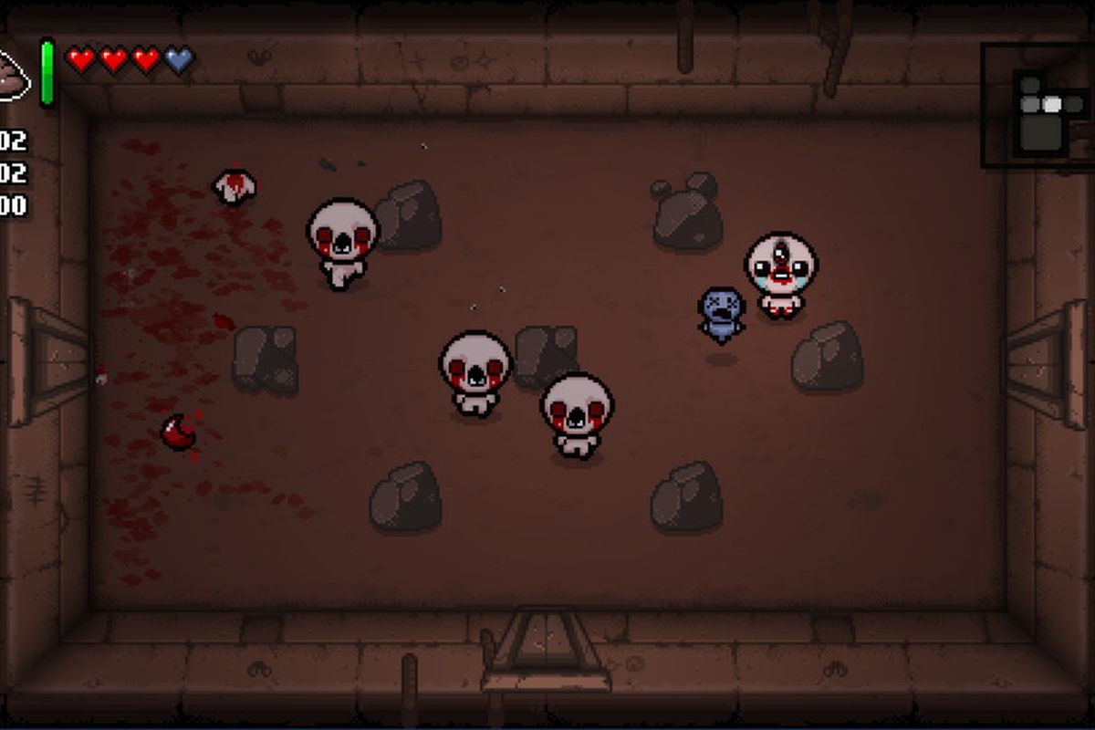
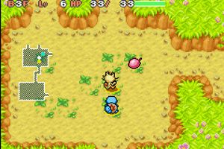
GAMES WITH SIMILAR MAP STYLES
THE BINDING OF ISAAC
POKéMON: MYSTERY DUNGEON

Slide 23
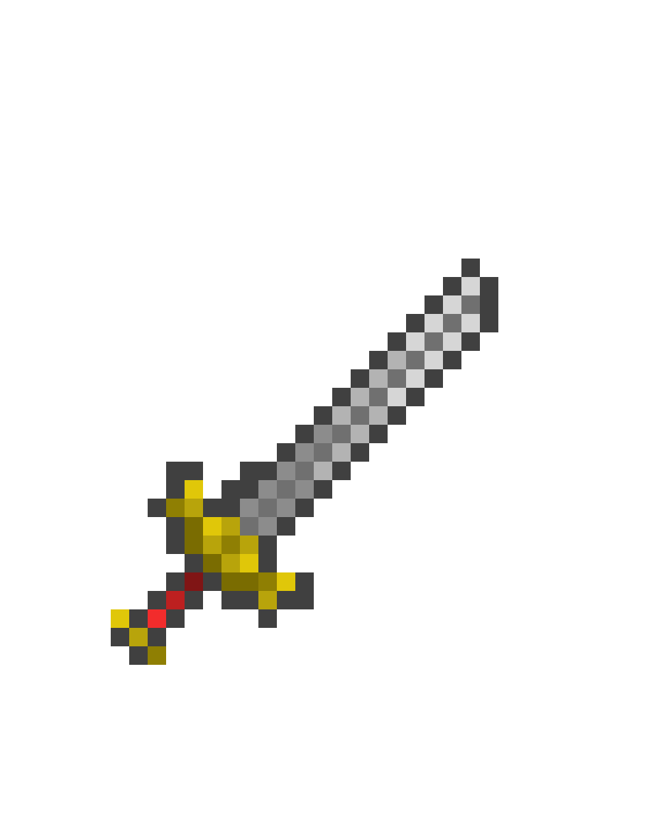

DESIGN CONCEPTS
-LEVEL DESIGN
-ENTRANCE/EXIT
-ENEMIES
-OBJECTS
-MECHANICS

Slide 24
CODE

Slide 25

TODO 1.
Load data through xml mapData

Slide 26
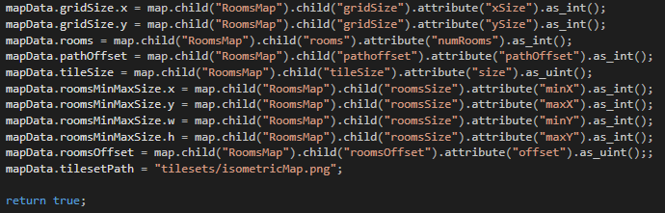
TODO 1.
SOLUTION

Slide 27

TODO 2.
Connect rooms using A*
(pathfinding algorithm)

Slide 28
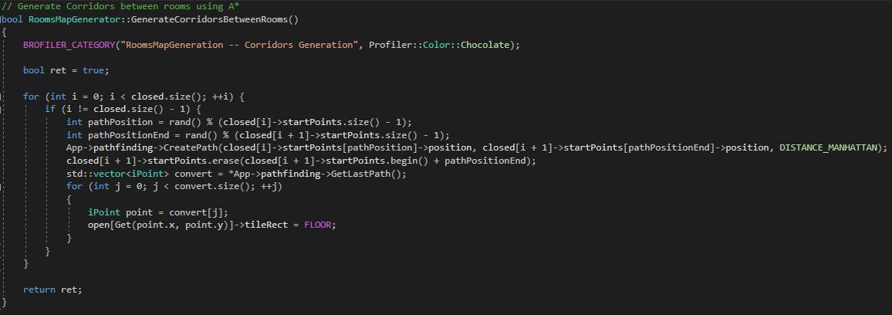
TODO 2.
SOLUTION

Slide 29

TODO 3.
Generate the walls

Slide 30
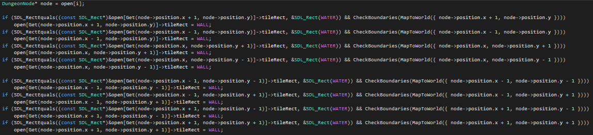
TODO 3.
SOLUTION

Slide 31
THANK YOU FOR YOUR ATTENTION
Github Account: Nadine044
Mail: Nadigupo@gmail.com

